Slide 1







GROUP 3
“ATTENDANCE
MANAGEMENT SYSTEM”

Slide 2









JOYSIS TECHVOC INC
MEET OUR TEAM
Jeffrey B. Ablazo
Aldrich M. Lising
Verna Erika Y. Gapas
DEVELOPER
LEADER
DEVELOPER

Slide 3



JOYSIS TECHVOC INC
MEET OUR TEAM
Princess Nicole S. Magalay
Geovenal A. Bernardo
Ronnielyn A. Manacob
DEVELOPER
DEVELOPER
DEVELOPER

Slide 4


JOYSIS TECHVOC INC
MEET OUR TEAM
Princess Josel T. Politico
Daniella B. Barcelon
Beatriz L. Mangao
DEVELOPER
DEVELOPER
DEVELOPER

Slide 5



TABLE OF CONTENTS
INTRODUCTION
SYSTEM ARCHITECTURE
DATABASE OUTLINE
SOURCE CODE OVERVIEW

Slide 6
TABLE OF CONTENTS
USER INTERFACE (UI) DESIGN
DAILY MEETINGS AND DEVELOPMENT PROCESS
SYSTEM PRESENTATION

Slide 7


PURPOSE AND OBJECTIVES
Automated Attendance Tracking: The system automates the attendance process, enabling quick and accurate logging of attendance data for students and employees.
User Management: Different user roles (Admin, Co-admin, and Student) have tailored access and functionalities, ensuring the system meets the needs of each user group.

Slide 8


PURPOSE AND OBJECTIVES
Real-Time Reporting: Admins and co-admins can easily generate and review attendance reports for better decision-making and performance tracking.
Security and Data Integrity: The system employs strong user authentication and encryption protocols to ensure the security of sensitive data.
Scalability: Designed to support future expansion, the system can handle a growing number of users and attendance records without compromising performance.

Slide 9

INTRODUCTION
The Attendance Management System (AMS) streamlines attendance tracking and reporting for educational institutions, addressing challenges like time-consuming, error-prone, and scalable methods. It provides a comprehensive solution for real-time attendance data management for administrators, co-admins, and students.

Slide 10
KEY STAKEHOLDERS
Admins: Responsible for overseeing the entire system, including user management, generating reports, and maintaining data integrity.
Co-admins: Assist the admins with certain administrative tasks, such as managing attendance, records and organizing events.
Students: Can mark their own attendance, view personal attendance records, and receive notifications for attendance-related events.

Slide 11


SYSTEM OVERVIEW
The system is built on a robust relational database that stores critical data such as user accounts, attendance logs, classes, and events. It integrates several features designed to improve both user experience and administrative control, such as:

Slide 12


SYSTEM OVERVIEW
User Authentication: Secure login and role-based access control for different user types (Admin, Co-admin, Student).
Class Management: Admins and co-admins can create, manage, and schedule classes.
Attendance Logging: Automatic logging of attendance during specified class times.
Event Management: Ability to schedule and track important events, such as exams or meetings.

Slide 13
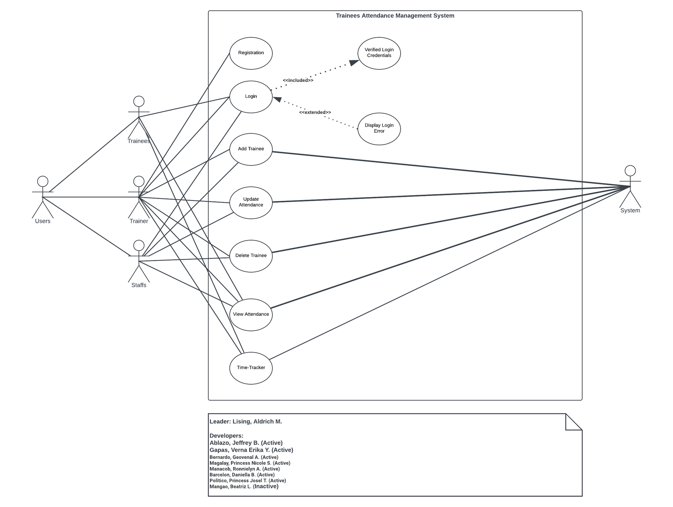
SYSTEM ARCHITECTURE

Slide 14
DATABASE OUTLINE

Slide 15


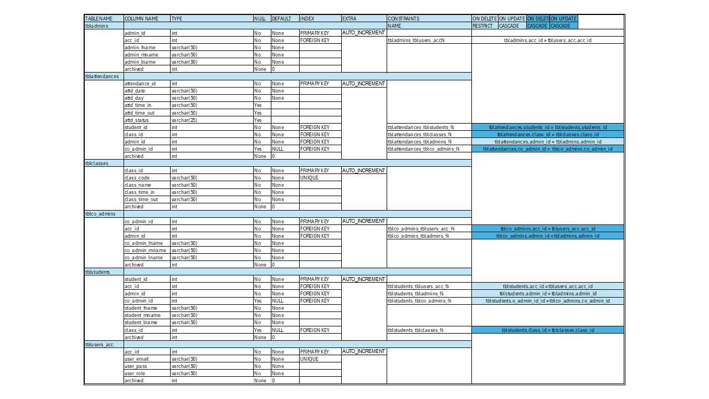
DATABASE OUTLINE

Slide 16
SOURCE CODES

Slide 17
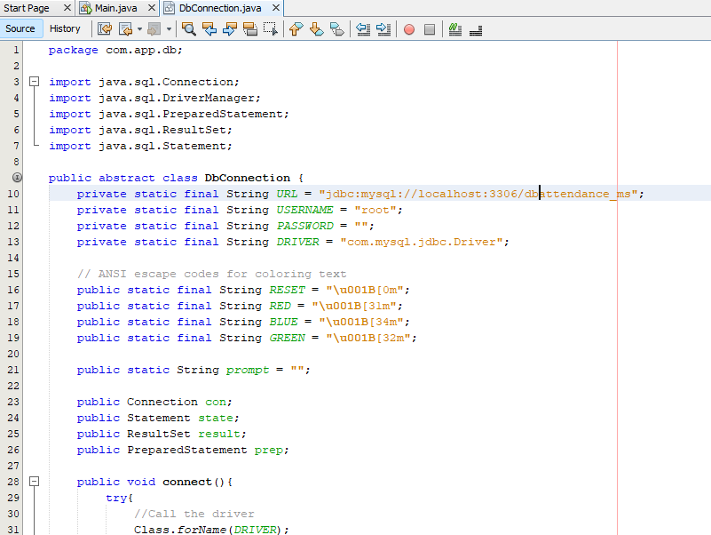
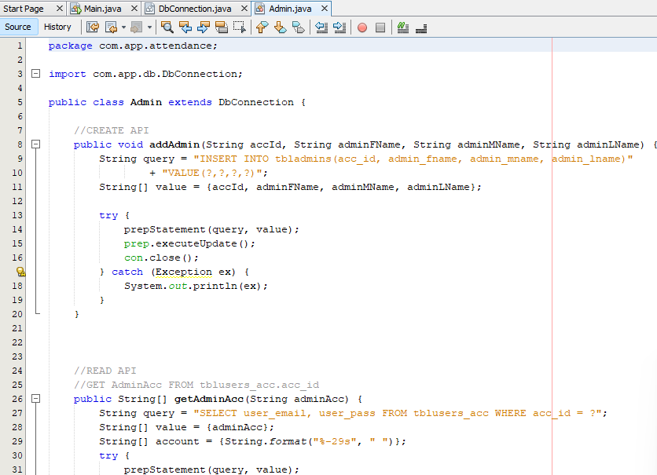
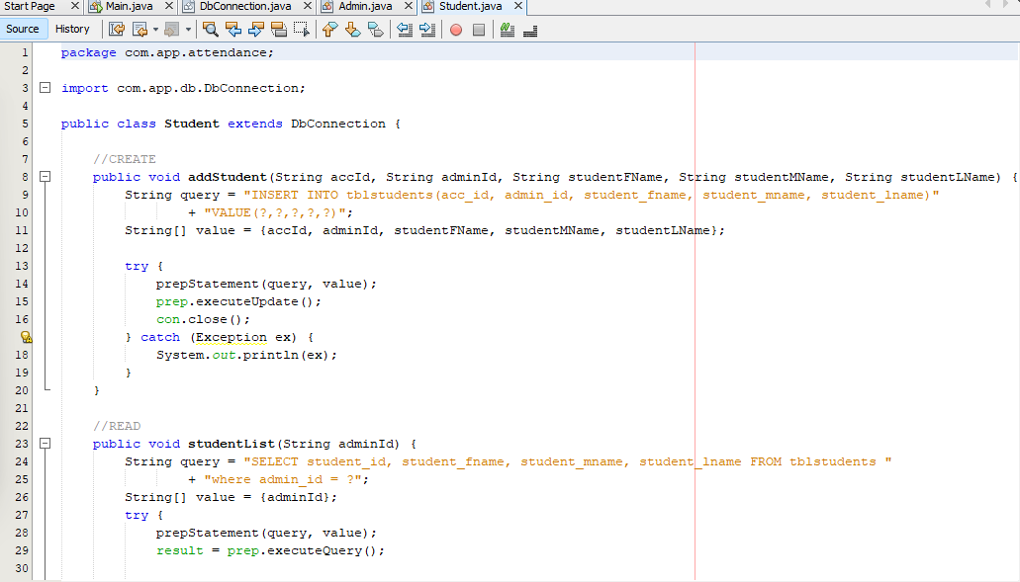
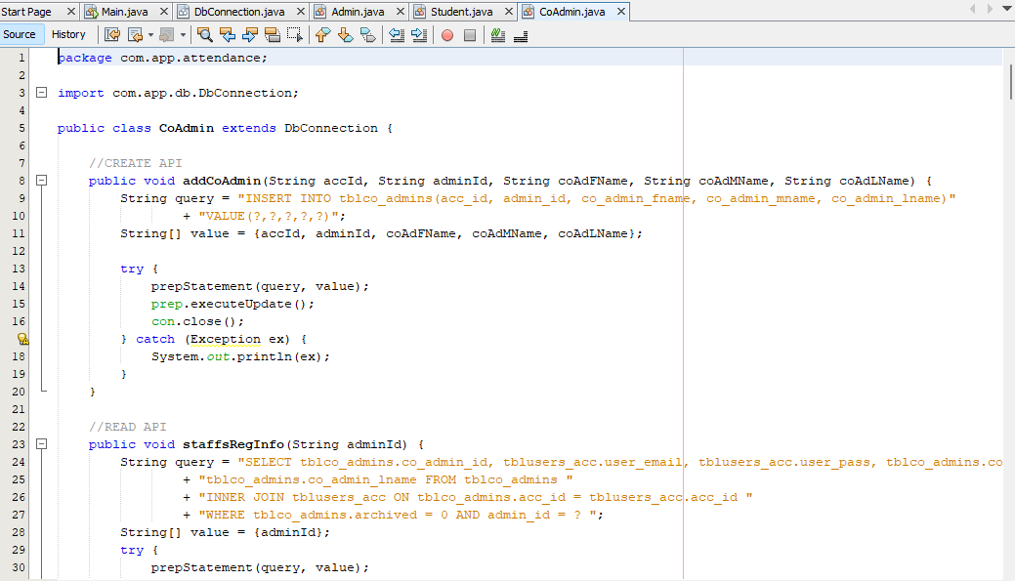
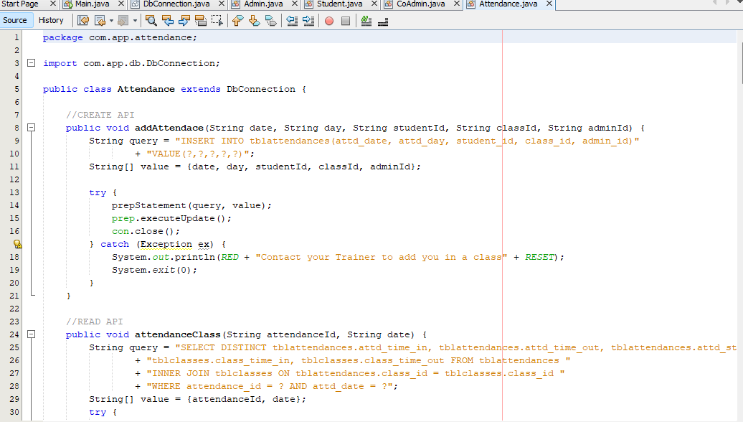
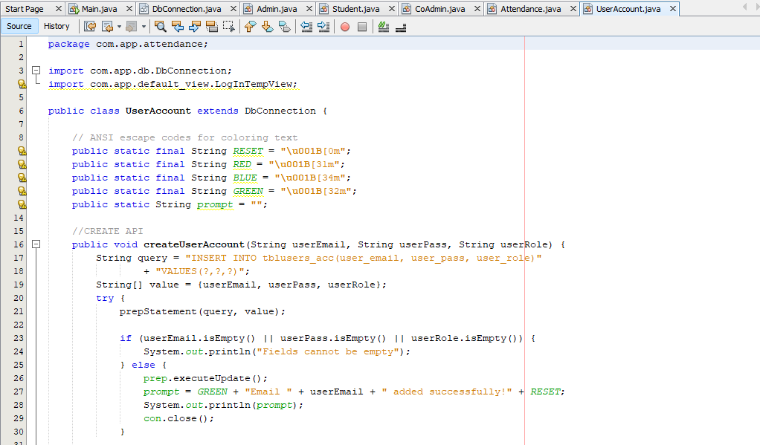
dbconnection
ADMIN CRUD
TRAINEE CRUD
CO ADMIN CRUD
ATTENDANCE
USER ACCOUNT

Slide 18
USER INTERFACE

Slide 19
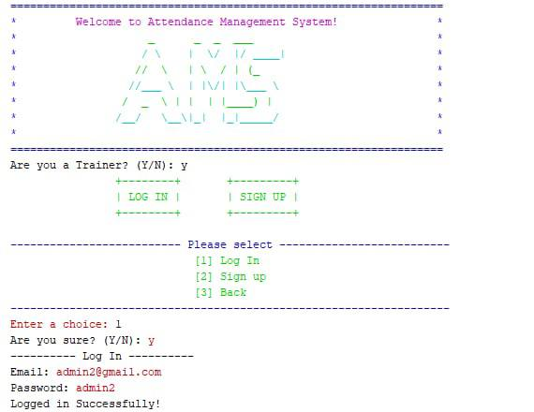

Slide 20
DAILY MEETINGS
(DOCUMENTATION)

Slide 21
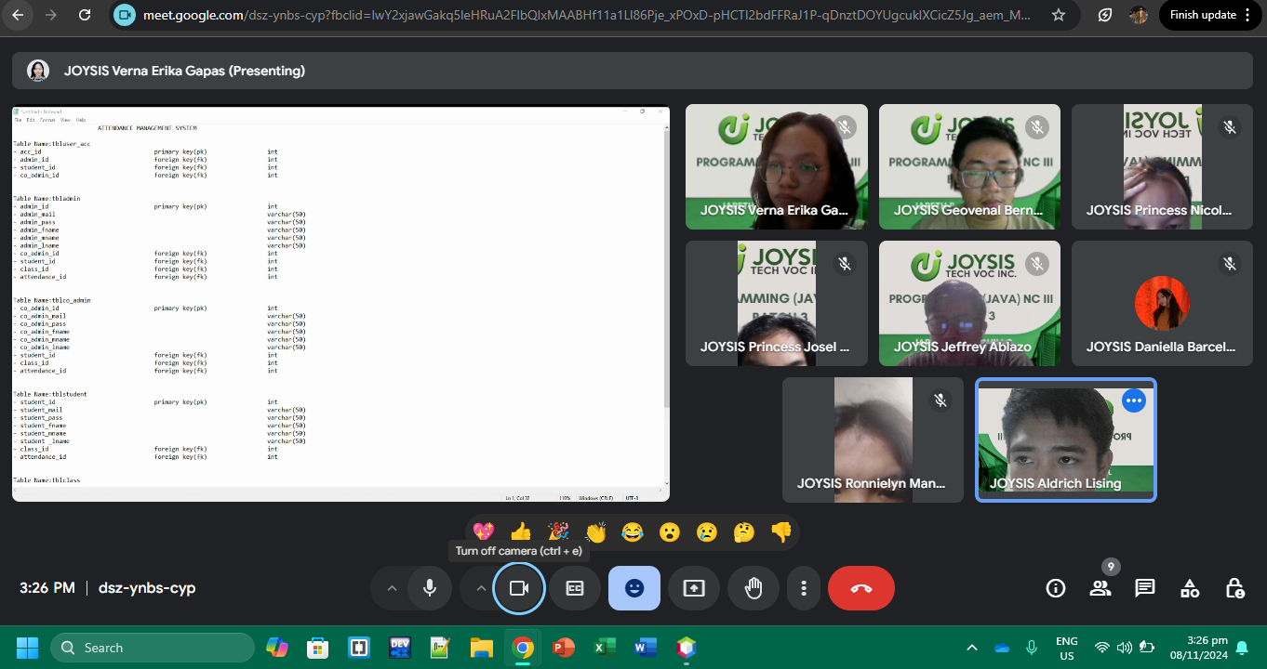
DAY 1

Slide 22
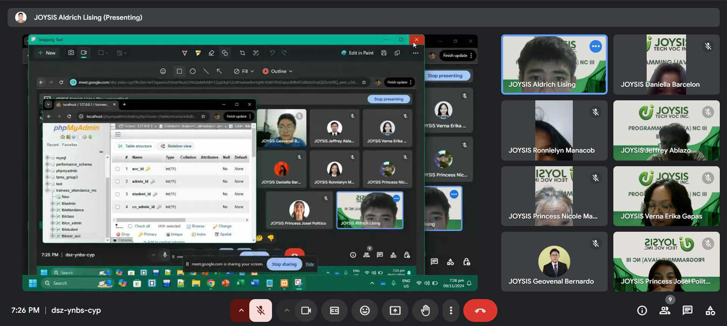
DAY 2

Slide 23
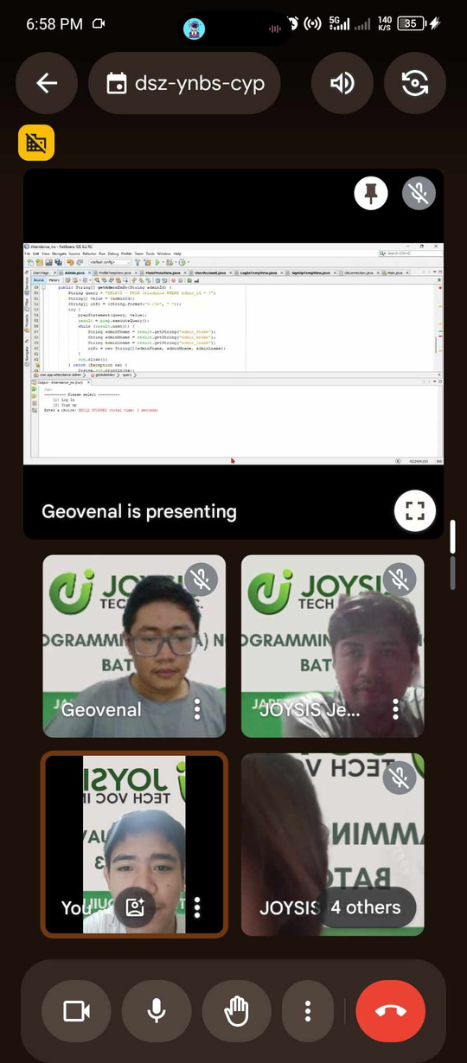
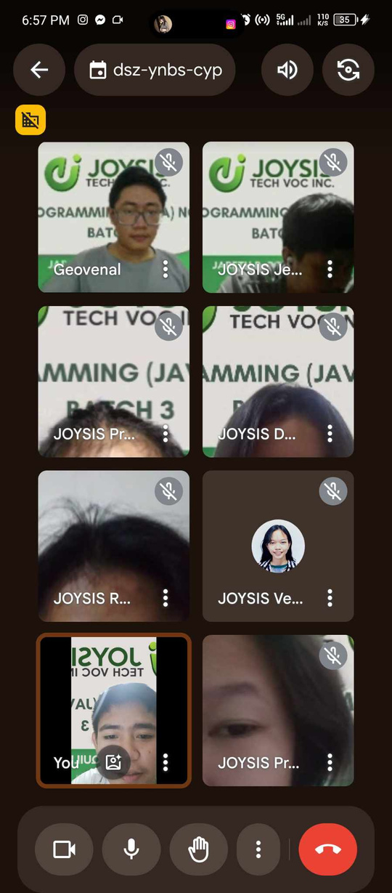
DAY 3

Slide 24
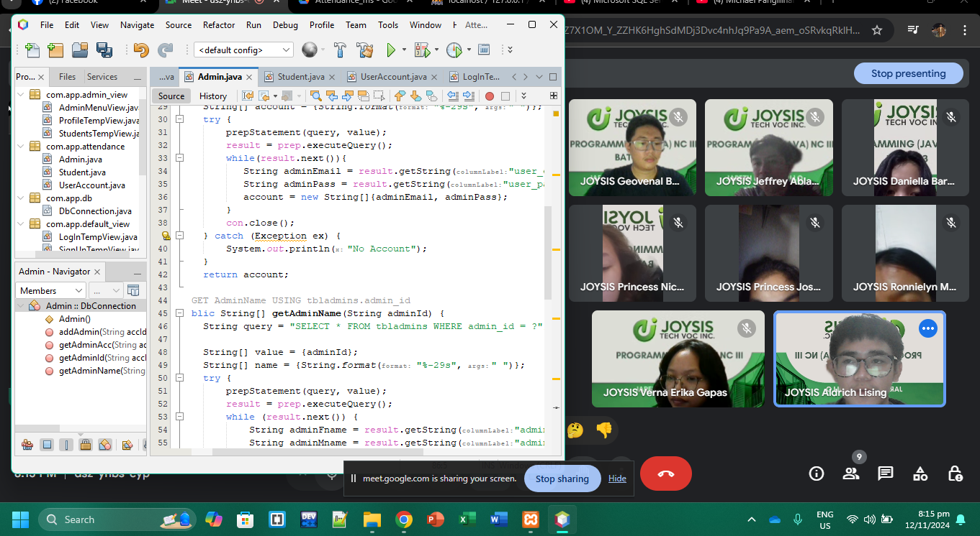
DAY 4

Slide 25
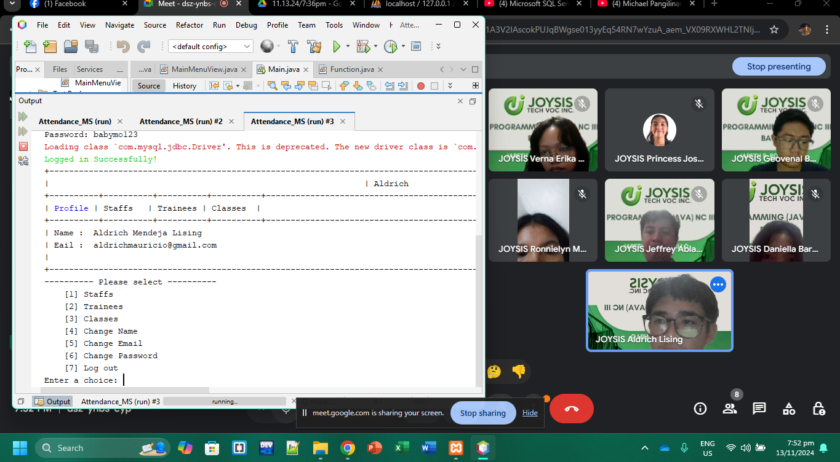
DAY 5

Slide 26
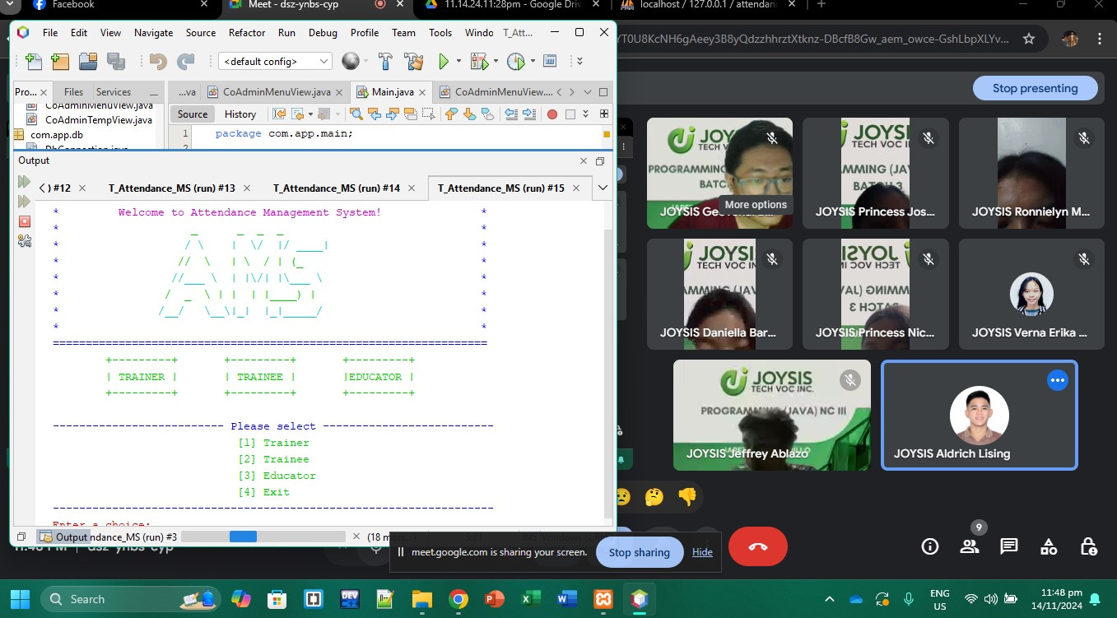
DAY 6

Slide 27
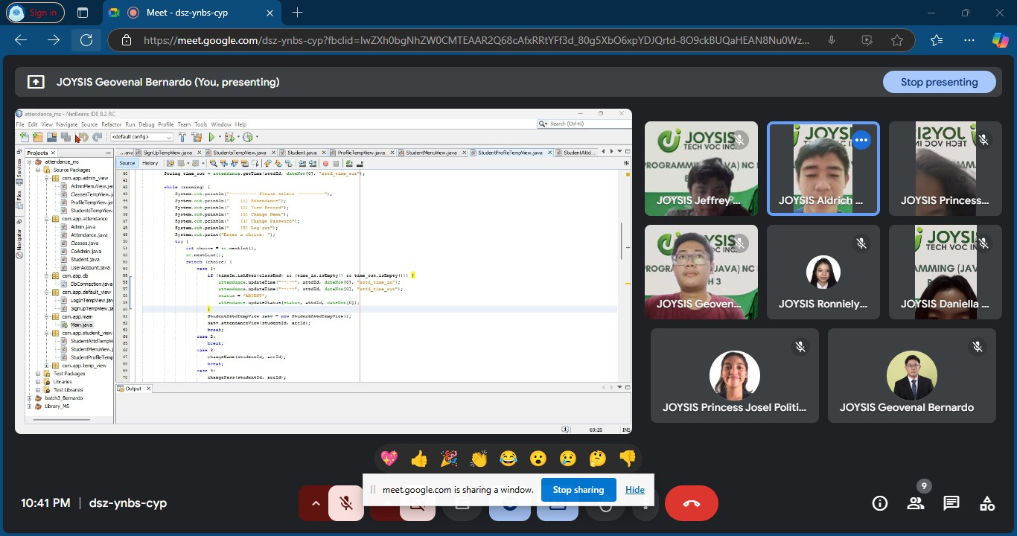
DAY 7

Slide 28
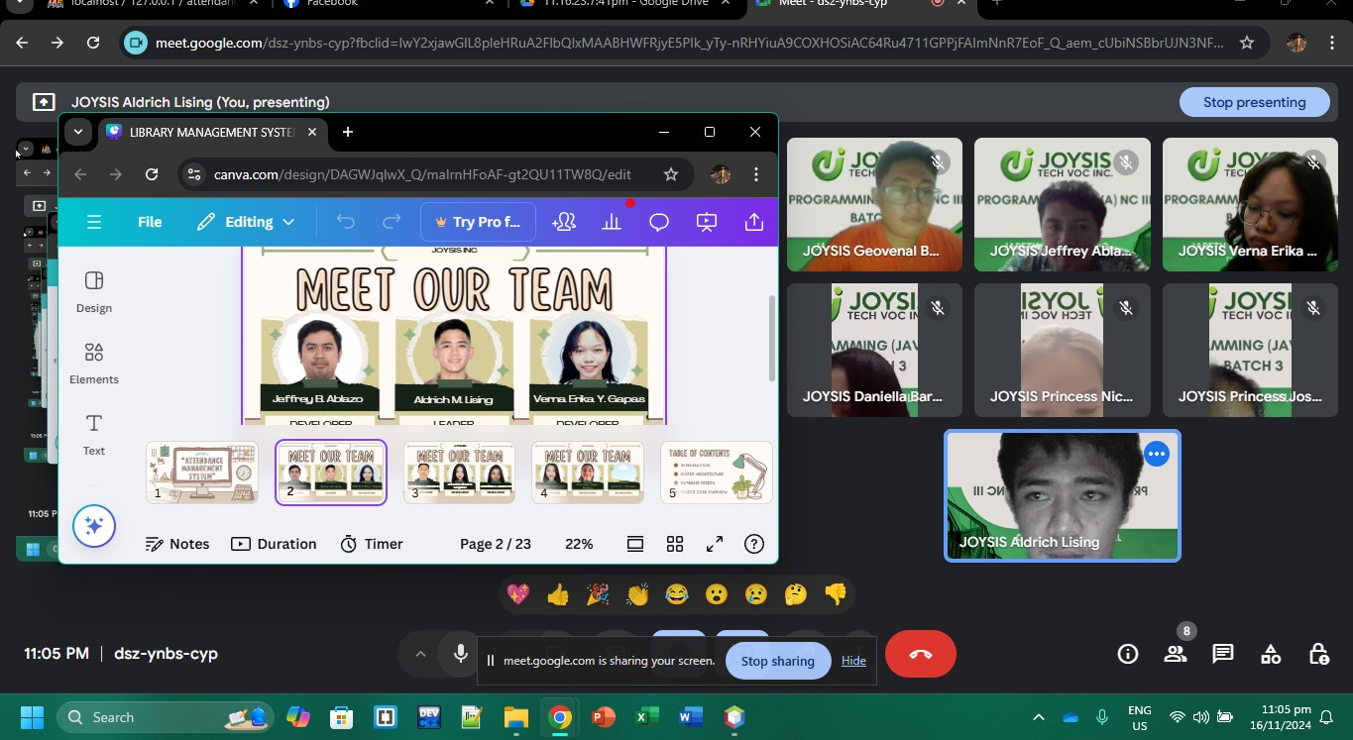
DAY8

Slide 29
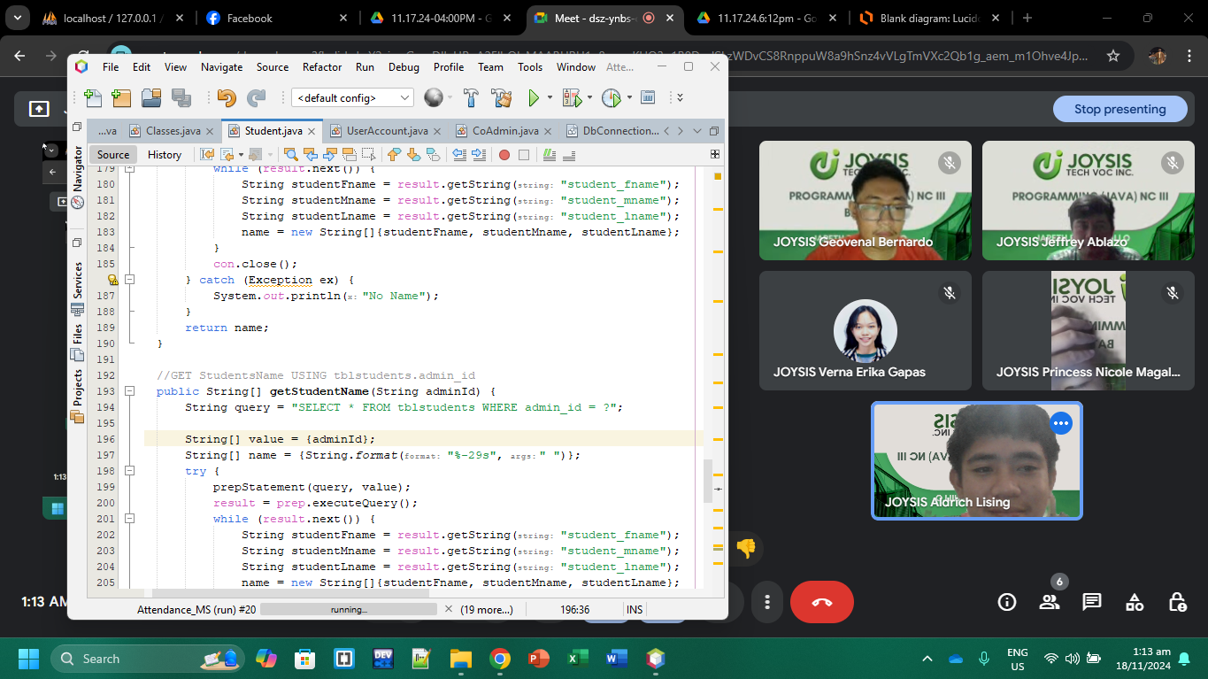
DAY9

Slide 30
SYSTEM PRESENTATION

Slide 31

CONCLUSION
In educational institutions, the Attendance Management System (AMS) is a great system utilized for attendance tracking and management in a secure, efficient, and scalable manner. Due to difficulties, errors, and ineffective ways typical of the old methods AMS resolves by automating processes of attendance taking with real-time reporting and provision of advanced user management tools. The differentiation by roles meets the needs of the administrators (trainer), co-admins (staff), and student users, creating a unique experience for the different groups. Being an automated system with a strong database security the system protects the data, ensures reliability, and responds to the future wishes of the modern institutions.

Slide 32

Q & A

Slide 33


THANK
YOU

